Slide 1
Green Synthesis and Characterization of Silver Nanoparticles Using Bitter Melon (Momordica Charantia) Extract
Azize ALAYLI¹, Hamza Malik OKUYAN² , Şeyda Öznur AYÇİÇEK², Hayrunnisa NADAROĞLU³
¹Department of Nursing, Faculty of Health Sciences, Sakarya University of Applied Sciences, Sakarya, Turkey
²Department of Physiotherapy and Rehabilitation, Faculty of Health Sciences, Physiotherapy and Rehabilitation Application and Research Center, Sakarya University of Applied Sciences, Sakarya, Turkey
³Department of Food Technology, Technical Vocational School, Atatürk University, Erzurum, Turkey

Slide 2
Presentation Plan
TURK2025
Introduction
Outline
Introduction
Materials and Method
Materials and Method
Results and Conclusion
Results
Overview
Notes:
In my presentation I’ll try to address
a little about, phase change materials and encapsulation
the encapsulated phase change material slurries and their performance,
Slurry Characterization, and
Results

Slide 3
Introduction
TURK2025
Nanotechnology involves manipulation of materials at the atomic/molecular level
Applications in medicine, electronics, and materials science
Nanobiotechnology:
Used in drug delivery, diagnostics, disease treatment and biomedical device development.
Nanoscale unique properties:
Quantum effects at nanoscale
High surface area → enhanced catalytic, optical, and electrical functions
Outline
Introduction
Materials and Method
Results and Conclusion
Notes:
Many appliances, such as electronic devices or any thermal system, require removal of heat for better efficiency. The removal of heat is almost always dependent on circulation or passing by of a fluid through parts of the system, which are generally referred to as heat sinks. Various fluids can be employed as a working fluid to draw the heat.
Air, for example, is easy to employ and low-cost but not that beneficial as a thermal agent.
Specifically made fluids offer a solution, but they are way to expensive to be economic to be used in most cases, and water is somewhat suboptimal for the purpose. Studies on development and use of fluids that have high specific heat capacity have gained momentum. Water with additives was considered to be a solution, but it increases pumping power required to circulate the water through the system, whereby a greater amount of power is spent to meet pumping power requirements.
Therefore, it is important to develop new fluids with higher specific heat capacity but are inexpensive, readily available and require lower pumping power.
A fair solution seemed to be water based fluids with additives. There are many water based fluids, nanoparticle added nanofluids for example. The idea is to be able to draw more heat per unit amount of fluid mass and with relatively less pumping power.

Slide 4
Introduction
TURK2025
Synthesis method:
Top-Down:
Reduces bulk materials to nanoparticles. Methods; milling, photolithography, etc.
Bottom-Up:
Builds particles from atoms/molecules. Methods; sol-gel, chemical vapor deposition, self-assembly
Classified as
Physical,
Chemical,
Biological (Green Synthesis)
Outline
Introduction
Materials and Method
Results and Conclusion
Notes:
Many appliances, such as electronic devices or any thermal system, require removal of heat for better efficiency. The removal of heat is almost always dependent on circulation or passing by of a fluid through parts of the system, which are generally referred to as heat sinks. Various fluids can be employed as a working fluid to draw the heat.
Air, for example, is easy to employ and low-cost but not that beneficial as a thermal agent.
Specifically made fluids offer a solution, but they are way to expensive to be economic to be used in most cases, and water is somewhat suboptimal for the purpose. Studies on development and use of fluids that have high specific heat capacity have gained momentum. Water with additives was considered to be a solution, but it increases pumping power required to circulate the water through the system, whereby a greater amount of power is spent to meet pumping power requirements.
Therefore, it is important to develop new fluids with higher specific heat capacity but are inexpensive, readily available and require lower pumping power.
A fair solution seemed to be water based fluids with additives. There are many water based fluids, nanoparticle added nanofluids for example. The idea is to be able to draw more heat per unit amount of fluid mass and with relatively less pumping power.

Slide 5
Introduction
TURK2025
Green Synthesis
Uses biological sources: Plants, bacteria, fungi, algae, etc.
Advantages:
Environmentally friendly
No toxic chemicals or stabilizers
Biocompatible and easy to purify
Our research group has synthesized various metal nanoparticles using different plant extracts. These nanoparticles have been employed in a variety of disciplines, including catalysis, antimicrobial activity, and pigment removal, due to their unique morphology and property characteristics
Outline
Introduction
Materials and Method
Results and Conclusion
Notes:
Many appliances, such as electronic devices or any thermal system, require removal of heat for better efficiency. The removal of heat is almost always dependent on circulation or passing by of a fluid through parts of the system, which are generally referred to as heat sinks. Various fluids can be employed as a working fluid to draw the heat.
Air, for example, is easy to employ and low-cost but not that beneficial as a thermal agent.
Specifically made fluids offer a solution, but they are way to expensive to be economic to be used in most cases, and water is somewhat suboptimal for the purpose. Studies on development and use of fluids that have high specific heat capacity have gained momentum. Water with additives was considered to be a solution, but it increases pumping power required to circulate the water through the system, whereby a greater amount of power is spent to meet pumping power requirements.
Therefore, it is important to develop new fluids with higher specific heat capacity but are inexpensive, readily available and require lower pumping power.
A fair solution seemed to be water based fluids with additives. There are many water based fluids, nanoparticle added nanofluids for example. The idea is to be able to draw more heat per unit amount of fluid mass and with relatively less pumping power.

Slide 6
Materials or Method
TURK2025
The synthesis of silver nanoparticles from Bitter Melon (Momordica charantia):
Faculty of Health Sciences of Sakarya University of Applied Sciences,
Characterization of the nanoparticles:
Laboratories of Atatürk University Erzurum Vocational School and DAYTAM.
Outline
Introduction
Materials and Method
Results and Conclusion
Notes:
Thermal energy can be stored as thermochemical heat, sensible heat or latent heat. Thermochemical heat storage is based on the occurrence of reversible endothermic / exothermic chemical reactions and is not suitable in most cases. If thermal energy is stored in the form of sensible heat, it is necessary to use a material with a high specific heat capacity, a long working life, which is also non-corrosive and non-toxic, yet thermal insulation is always required during storage.
However, PCM materials offer both higher energy storage density, thanks to that they exchange heat at constant temperature, and storage of energy in the form of latent heat, and they provide important advantages especially in systems where an optimum working temperature must be maintained.
PCM materials are available with a wide range of fusion energy from -5 degrees to 150 degrees. Compared to sensible heat storage, PCM materials increase the amount of energy stored per unit volume 5 to 14 folds.
In order to make sure that the PCM materials will serve for the purpose, they have to possess some thermodynamic, kinetic, physical, and chemical properties.
From a thermodynamic point of view:
They should have the highest possible latent heat of fusion, since it provides the maximum amount of heat that can be stored in a unit volume.
Since the solid-liquid phase change takes place at a constant temperature, this temperature value must be equal to the optimum operating temperature of the system to be used.
The volumetric change between the phases should be very small and the vapor pressure is low because it will be contained in a closed system.
The thermal conductivity and density are high and the phase changes are stable over time.
In terms of kinetic, the rate of nucleation and the rate of crystal growth must be large.
They should be non-toxic, have long economic life, be not harmful to health, be low-cost and easily suppliable.

Slide 7
Materials or Method
TURK2025
Collection and Extraction of Bitter Melon
Harvest Time: August–September 2024, Sakarya Province
Quantity Used: 500 g of fresh bitter melon fruits
Washing: Cleaned with distilled water to remove surface impurities
Seed Removal: Seeds were separated from the fruit
Pressing: Aqueous layer from seeds extracted by pressing
Filtration: Solid particles removed by filtration
Concentration: 50 mL of juice reduced to 10 mL using an evaporator
Storage: Stored at +4 °C in a refrigerator until use
Outline
Introduction
Materials and Method
Results and Conclusion
Notes:
Thermal energy can be stored as thermochemical heat, sensible heat or latent heat. Thermochemical heat storage is based on the occurrence of reversible endothermic / exothermic chemical reactions and is not suitable in most cases. If thermal energy is stored in the form of sensible heat, it is necessary to use a material with a high specific heat capacity, a long working life, which is also non-corrosive and non-toxic, yet thermal insulation is always required during storage.
However, PCM materials offer both higher energy storage density, thanks to that they exchange heat at constant temperature, and storage of energy in the form of latent heat, and they provide important advantages especially in systems where an optimum working temperature must be maintained.
PCM materials are available with a wide range of fusion energy from -5 degrees to 150 degrees. Compared to sensible heat storage, PCM materials increase the amount of energy stored per unit volume 5 to 14 folds.
In order to make sure that the PCM materials will serve for the purpose, they have to possess some thermodynamic, kinetic, physical, and chemical properties.
From a thermodynamic point of view:
They should have the highest possible latent heat of fusion, since it provides the maximum amount of heat that can be stored in a unit volume.
Since the solid-liquid phase change takes place at a constant temperature, this temperature value must be equal to the optimum operating temperature of the system to be used.
The volumetric change between the phases should be very small and the vapor pressure is low because it will be contained in a closed system.
The thermal conductivity and density are high and the phase changes are stable over time.
In terms of kinetic, the rate of nucleation and the rate of crystal growth must be large.
They should be non-toxic, have long economic life, be not harmful to health, be low-cost and easily suppliable.

Slide 8
Materials or Method
TURK2025
Green Synthesis of Silver Nanoparticles with Bitter Melon
⚗️ Synthesis Procedure
1.7 g AgNO₃ dissolved in 100 mL distilled water (two-neck flask)
5 mL of Bitter Melon extract added
Mixture refluxed at 85 °C for 2 hours using a magnetic stirrer with a condenser
After cooling to room temperature, the solution was further stirred
Outline
Introduction
Materials and Method
Results and Conclusion
Notes:
Thermal energy can be stored as thermochemical heat, sensible heat or latent heat. Thermochemical heat storage is based on the occurrence of reversible endothermic / exothermic chemical reactions and is not suitable in most cases. If thermal energy is stored in the form of sensible heat, it is necessary to use a material with a high specific heat capacity, a long working life, which is also non-corrosive and non-toxic, yet thermal insulation is always required during storage.
However, PCM materials offer both higher energy storage density, thanks to that they exchange heat at constant temperature, and storage of energy in the form of latent heat, and they provide important advantages especially in systems where an optimum working temperature must be maintained.
PCM materials are available with a wide range of fusion energy from -5 degrees to 150 degrees. Compared to sensible heat storage, PCM materials increase the amount of energy stored per unit volume 5 to 14 folds.
In order to make sure that the PCM materials will serve for the purpose, they have to possess some thermodynamic, kinetic, physical, and chemical properties.
From a thermodynamic point of view:
They should have the highest possible latent heat of fusion, since it provides the maximum amount of heat that can be stored in a unit volume.
Since the solid-liquid phase change takes place at a constant temperature, this temperature value must be equal to the optimum operating temperature of the system to be used.
The volumetric change between the phases should be very small and the vapor pressure is low because it will be contained in a closed system.
The thermal conductivity and density are high and the phase changes are stable over time.
In terms of kinetic, the rate of nucleation and the rate of crystal growth must be large.
They should be non-toxic, have long economic life, be not harmful to health, be low-cost and easily suppliable.

Slide 9
Materials or Method
TURK2025
Green Synthesis of Silver Nanoparticles with Bitter Melon
🧼 Purification
Washed with distilled water and ethanol
Centrifugation: 6,000 rpm for 5 minutes each
Drying: Overnight at 60 °C
Storage: At room temperature
Outline
Introduction
Materials and Method
Results and Conclusion
Notes:
Thermal energy can be stored as thermochemical heat, sensible heat or latent heat. Thermochemical heat storage is based on the occurrence of reversible endothermic / exothermic chemical reactions and is not suitable in most cases. If thermal energy is stored in the form of sensible heat, it is necessary to use a material with a high specific heat capacity, a long working life, which is also non-corrosive and non-toxic, yet thermal insulation is always required during storage.
However, PCM materials offer both higher energy storage density, thanks to that they exchange heat at constant temperature, and storage of energy in the form of latent heat, and they provide important advantages especially in systems where an optimum working temperature must be maintained.
PCM materials are available with a wide range of fusion energy from -5 degrees to 150 degrees. Compared to sensible heat storage, PCM materials increase the amount of energy stored per unit volume 5 to 14 folds.
In order to make sure that the PCM materials will serve for the purpose, they have to possess some thermodynamic, kinetic, physical, and chemical properties.
From a thermodynamic point of view:
They should have the highest possible latent heat of fusion, since it provides the maximum amount of heat that can be stored in a unit volume.
Since the solid-liquid phase change takes place at a constant temperature, this temperature value must be equal to the optimum operating temperature of the system to be used.
The volumetric change between the phases should be very small and the vapor pressure is low because it will be contained in a closed system.
The thermal conductivity and density are high and the phase changes are stable over time.
In terms of kinetic, the rate of nucleation and the rate of crystal growth must be large.
They should be non-toxic, have long economic life, be not harmful to health, be low-cost and easily suppliable.

Slide 10
Materials or Method
TURK2025
Green Synthesis of Silver Nanoparticles with Bitter Melon
Biochemical reduction followed by oxidation with environmental oxygen
Outline
Introduction
Materials and Method
Results and Conclusion
Notes:
Thermal energy can be stored as thermochemical heat, sensible heat or latent heat. Thermochemical heat storage is based on the occurrence of reversible endothermic / exothermic chemical reactions and is not suitable in most cases. If thermal energy is stored in the form of sensible heat, it is necessary to use a material with a high specific heat capacity, a long working life, which is also non-corrosive and non-toxic, yet thermal insulation is always required during storage.
However, PCM materials offer both higher energy storage density, thanks to that they exchange heat at constant temperature, and storage of energy in the form of latent heat, and they provide important advantages especially in systems where an optimum working temperature must be maintained.
PCM materials are available with a wide range of fusion energy from -5 degrees to 150 degrees. Compared to sensible heat storage, PCM materials increase the amount of energy stored per unit volume 5 to 14 folds.
In order to make sure that the PCM materials will serve for the purpose, they have to possess some thermodynamic, kinetic, physical, and chemical properties.
From a thermodynamic point of view:
They should have the highest possible latent heat of fusion, since it provides the maximum amount of heat that can be stored in a unit volume.
Since the solid-liquid phase change takes place at a constant temperature, this temperature value must be equal to the optimum operating temperature of the system to be used.
The volumetric change between the phases should be very small and the vapor pressure is low because it will be contained in a closed system.
The thermal conductivity and density are high and the phase changes are stable over time.
In terms of kinetic, the rate of nucleation and the rate of crystal growth must be large.
They should be non-toxic, have long economic life, be not harmful to health, be low-cost and easily suppliable.

Slide 11
Materials or Method
TURK2025
Interaction Time;
Samples were taken every 5 minutes for 240 minutes during the synthesis.
Absorbance measurements were recorded.
Distilled water was used as the blank.
The time of maximum nanoparticle formation was determined.
Outline
Introduction
Materials and Method
Results and Conclusion
Notes:
Thermal energy can be stored as thermochemical heat, sensible heat or latent heat. Thermochemical heat storage is based on the occurrence of reversible endothermic / exothermic chemical reactions and is not suitable in most cases. If thermal energy is stored in the form of sensible heat, it is necessary to use a material with a high specific heat capacity, a long working life, which is also non-corrosive and non-toxic, yet thermal insulation is always required during storage.
However, PCM materials offer both higher energy storage density, thanks to that they exchange heat at constant temperature, and storage of energy in the form of latent heat, and they provide important advantages especially in systems where an optimum working temperature must be maintained.
PCM materials are available with a wide range of fusion energy from -5 degrees to 150 degrees. Compared to sensible heat storage, PCM materials increase the amount of energy stored per unit volume 5 to 14 folds.
In order to make sure that the PCM materials will serve for the purpose, they have to possess some thermodynamic, kinetic, physical, and chemical properties.
From a thermodynamic point of view:
They should have the highest possible latent heat of fusion, since it provides the maximum amount of heat that can be stored in a unit volume.
Since the solid-liquid phase change takes place at a constant temperature, this temperature value must be equal to the optimum operating temperature of the system to be used.
The volumetric change between the phases should be very small and the vapor pressure is low because it will be contained in a closed system.
The thermal conductivity and density are high and the phase changes are stable over time.
In terms of kinetic, the rate of nucleation and the rate of crystal growth must be large.
They should be non-toxic, have long economic life, be not harmful to health, be low-cost and easily suppliable.

Slide 12
Materials or Method
TURK2025
Optimum pH;
Reactions were performed at pH values between 3 and 11.
Changes in absorbance were monitored spectrophotometrically
The optimal pH for Ag₂O nanoparticle formation was identified.
Outline
Introduction
Materials and Method
Results and Conclusion
Notes:
Thermal energy can be stored as thermochemical heat, sensible heat or latent heat. Thermochemical heat storage is based on the occurrence of reversible endothermic / exothermic chemical reactions and is not suitable in most cases. If thermal energy is stored in the form of sensible heat, it is necessary to use a material with a high specific heat capacity, a long working life, which is also non-corrosive and non-toxic, yet thermal insulation is always required during storage.
However, PCM materials offer both higher energy storage density, thanks to that they exchange heat at constant temperature, and storage of energy in the form of latent heat, and they provide important advantages especially in systems where an optimum working temperature must be maintained.
PCM materials are available with a wide range of fusion energy from -5 degrees to 150 degrees. Compared to sensible heat storage, PCM materials increase the amount of energy stored per unit volume 5 to 14 folds.
In order to make sure that the PCM materials will serve for the purpose, they have to possess some thermodynamic, kinetic, physical, and chemical properties.
From a thermodynamic point of view:
They should have the highest possible latent heat of fusion, since it provides the maximum amount of heat that can be stored in a unit volume.
Since the solid-liquid phase change takes place at a constant temperature, this temperature value must be equal to the optimum operating temperature of the system to be used.
The volumetric change between the phases should be very small and the vapor pressure is low because it will be contained in a closed system.
The thermal conductivity and density are high and the phase changes are stable over time.
In terms of kinetic, the rate of nucleation and the rate of crystal growth must be large.
They should be non-toxic, have long economic life, be not harmful to health, be low-cost and easily suppliable.

Slide 13
Materials or Method
TURK2025
OptimumTemperature;
Reactions were conducted between 10 °C and 90 °C.
Samples were compared against blank solutions.
Absorbance variations were measured to determine the optimal temperature for synthesis.
Outline
Introduction
Materials and Method
Results and Conclusion
Notes:
Thermal energy can be stored as thermochemical heat, sensible heat or latent heat. Thermochemical heat storage is based on the occurrence of reversible endothermic / exothermic chemical reactions and is not suitable in most cases. If thermal energy is stored in the form of sensible heat, it is necessary to use a material with a high specific heat capacity, a long working life, which is also non-corrosive and non-toxic, yet thermal insulation is always required during storage.
However, PCM materials offer both higher energy storage density, thanks to that they exchange heat at constant temperature, and storage of energy in the form of latent heat, and they provide important advantages especially in systems where an optimum working temperature must be maintained.
PCM materials are available with a wide range of fusion energy from -5 degrees to 150 degrees. Compared to sensible heat storage, PCM materials increase the amount of energy stored per unit volume 5 to 14 folds.
In order to make sure that the PCM materials will serve for the purpose, they have to possess some thermodynamic, kinetic, physical, and chemical properties.
From a thermodynamic point of view:
They should have the highest possible latent heat of fusion, since it provides the maximum amount of heat that can be stored in a unit volume.
Since the solid-liquid phase change takes place at a constant temperature, this temperature value must be equal to the optimum operating temperature of the system to be used.
The volumetric change between the phases should be very small and the vapor pressure is low because it will be contained in a closed system.
The thermal conductivity and density are high and the phase changes are stable over time.
In terms of kinetic, the rate of nucleation and the rate of crystal growth must be large.
They should be non-toxic, have long economic life, be not harmful to health, be low-cost and easily suppliable.

Slide 14
Materials or Method
TURK2025
Characterization of Silver Nanoparticles
It was carried out at the Eastern Anatolia High Technology Application and Research Center (DAYTAM) of Atatürk University.
Used Instrument:
UV-Vis Spectrophotometer
Scanning Electron Microscope (SEM)
Zeiss Sigma 300 model (with EDX capability)
Transmission Electron Microscope (TEM)
Hitachi HT 7700 model.
Outline
Introduction
Materials and Method
Results and Conclusion
Notes:
Thermal energy can be stored as thermochemical heat, sensible heat or latent heat. Thermochemical heat storage is based on the occurrence of reversible endothermic / exothermic chemical reactions and is not suitable in most cases. If thermal energy is stored in the form of sensible heat, it is necessary to use a material with a high specific heat capacity, a long working life, which is also non-corrosive and non-toxic, yet thermal insulation is always required during storage.
However, PCM materials offer both higher energy storage density, thanks to that they exchange heat at constant temperature, and storage of energy in the form of latent heat, and they provide important advantages especially in systems where an optimum working temperature must be maintained.
PCM materials are available with a wide range of fusion energy from -5 degrees to 150 degrees. Compared to sensible heat storage, PCM materials increase the amount of energy stored per unit volume 5 to 14 folds.
In order to make sure that the PCM materials will serve for the purpose, they have to possess some thermodynamic, kinetic, physical, and chemical properties.
From a thermodynamic point of view:
They should have the highest possible latent heat of fusion, since it provides the maximum amount of heat that can be stored in a unit volume.
Since the solid-liquid phase change takes place at a constant temperature, this temperature value must be equal to the optimum operating temperature of the system to be used.
The volumetric change between the phases should be very small and the vapor pressure is low because it will be contained in a closed system.
The thermal conductivity and density are high and the phase changes are stable over time.
In terms of kinetic, the rate of nucleation and the rate of crystal growth must be large.
They should be non-toxic, have long economic life, be not harmful to health, be low-cost and easily suppliable.

Slide 15
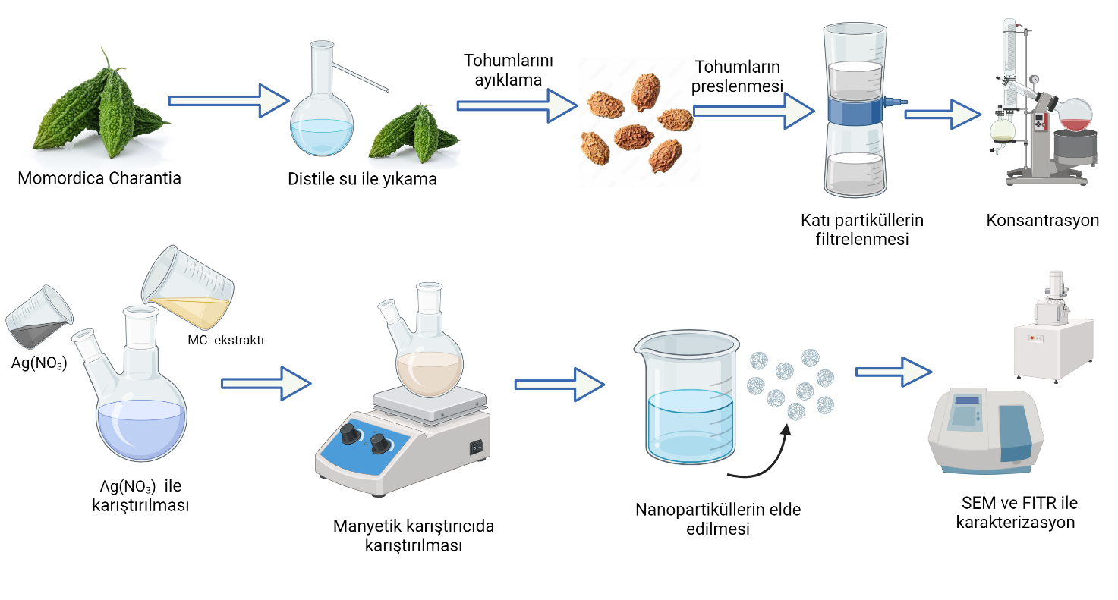
Materials or Method
TURK2025
Seed removing
Pressing
Outline
Introduction
Washing
Filtration
Concentration
Materials and Method
Results and Conclusion
Ag(NO₃) and MC extract mix
Synthesis of nanoparticles
Characterization
Notes:
Thermal energy can be stored as thermochemical heat, sensible heat or latent heat. Thermochemical heat storage is based on the occurrence of reversible endothermic / exothermic chemical reactions and is not suitable in most cases. If thermal energy is stored in the form of sensible heat, it is necessary to use a material with a high specific heat capacity, a long working life, which is also non-corrosive and non-toxic, yet thermal insulation is always required during storage.
However, PCM materials offer both higher energy storage density, thanks to that they exchange heat at constant temperature, and storage of energy in the form of latent heat, and they provide important advantages especially in systems where an optimum working temperature must be maintained.
PCM materials are available with a wide range of fusion energy from -5 degrees to 150 degrees. Compared to sensible heat storage, PCM materials increase the amount of energy stored per unit volume 5 to 14 folds.
In order to make sure that the PCM materials will serve for the purpose, they have to possess some thermodynamic, kinetic, physical, and chemical properties.
From a thermodynamic point of view:
They should have the highest possible latent heat of fusion, since it provides the maximum amount of heat that can be stored in a unit volume.
Since the solid-liquid phase change takes place at a constant temperature, this temperature value must be equal to the optimum operating temperature of the system to be used.
The volumetric change between the phases should be very small and the vapor pressure is low because it will be contained in a closed system.
The thermal conductivity and density are high and the phase changes are stable over time.
In terms of kinetic, the rate of nucleation and the rate of crystal growth must be large.
They should be non-toxic, have long economic life, be not harmful to health, be low-cost and easily suppliable.

Slide 16
Results and Discussion
TURK2025
Following the green synthesis, the SEM images revealed the formation of silver nanoparticles with a spherical morphology. To gain a more accurate understanding of particle size, TEM analysis was performed, which demonstrated that the nanoparticles were significantly smaller and exhibited a spherical, homogeneous distribution. As understood from the TEM results, this method successfully synthesized homogeneous, spherical silver nanoparticles smaller than 10 nm. These analyses provided valuable insights into the size and morphological properties of the synthesized nanoparticles.
Outline
Introduction
Materials and Method
Results and Conclusion
Notes:
In general, all thermodynamic properties of fluids used in heat extraction from the thermal systems are important. The specific heat capacity and viscosity of the fluid is determinative in the first place in terms of the pumping power required to circulate the fluid in the system.
For air and water, the flow rate of the fluid that corresponds to the total heat required to be drawn from the system is high due to lower specific heat capacities.
Whether it is an air fan or a water pump, greater flow rates require more power to circulate the fluid. As can be seen in the graph, the pumping power required to draw a certain amount of heat with encapsulated PCM slurries is gradually lower compared to pure water, especially for higher rates.
For example, in order to draw 1000 Watts of Heat, with pure water we need almost five folds pumping power.
Also, the relationship between the pumping power and the heat drawn is parabolic for pure water, while it is almost linear for aqueous encapsulated PCM slurries.

Slide 17
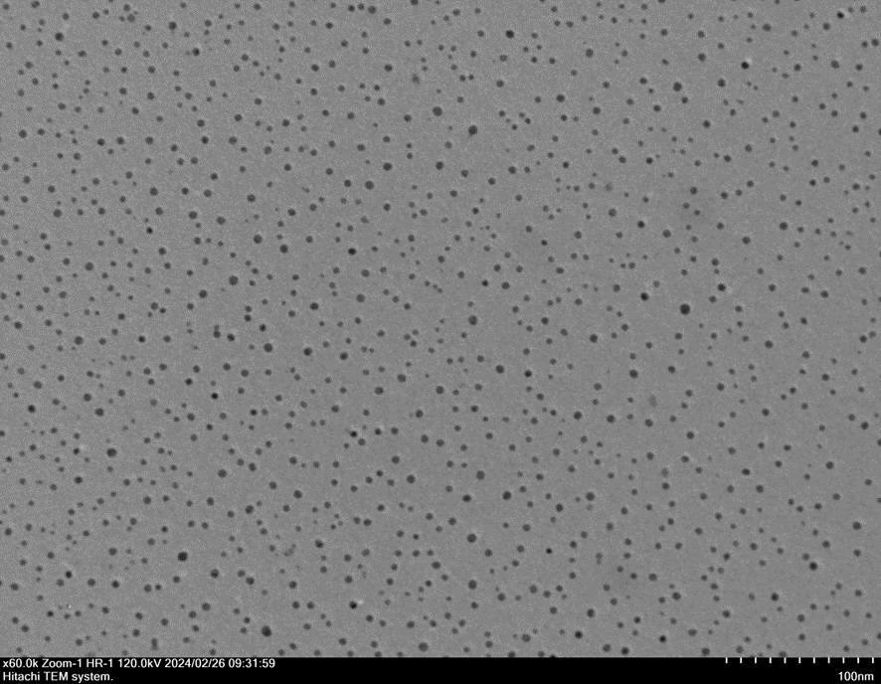
Results and Discussion
TURK2025
Outline
Introduction
Materials and Method
Results and Conclusion
Figure 1. The TEM image of silver nanoparticles synthesized with Bitter Melon extract.
Notes:
In general, all thermodynamic properties of fluids used in heat extraction from the thermal systems are important. The specific heat capacity and viscosity of the fluid is determinative in the first place in terms of the pumping power required to circulate the fluid in the system.
For air and water, the flow rate of the fluid that corresponds to the total heat required to be drawn from the system is high due to lower specific heat capacities.
Whether it is an air fan or a water pump, greater flow rates require more power to circulate the fluid. As can be seen in the graph, the pumping power required to draw a certain amount of heat with encapsulated PCM slurries is gradually lower compared to pure water, especially for higher rates.
For example, in order to draw 1000 Watts of Heat, with pure water we need almost five folds pumping power.
Also, the relationship between the pumping power and the heat drawn is parabolic for pure water, while it is almost linear for aqueous encapsulated PCM slurries.

Slide 18
Results and Discussion
TURK2025
To better understand the elemental and morphological characterization of the synthesized silver nanoparticles, SEM-EDS analysis was performed. The results confirmed that high-purity silver oxide nanoparticles were obtained.
Outline
Introduction
Materials and Method
Results and Conclusion
Notes:
In general, all thermodynamic properties of fluids used in heat extraction from the thermal systems are important. The specific heat capacity and viscosity of the fluid is determinative in the first place in terms of the pumping power required to circulate the fluid in the system.
For air and water, the flow rate of the fluid that corresponds to the total heat required to be drawn from the system is high due to lower specific heat capacities.
Whether it is an air fan or a water pump, greater flow rates require more power to circulate the fluid. As can be seen in the graph, the pumping power required to draw a certain amount of heat with encapsulated PCM slurries is gradually lower compared to pure water, especially for higher rates.
For example, in order to draw 1000 Watts of Heat, with pure water we need almost five folds pumping power.
Also, the relationship between the pumping power and the heat drawn is parabolic for pure water, while it is almost linear for aqueous encapsulated PCM slurries.

Slide 19
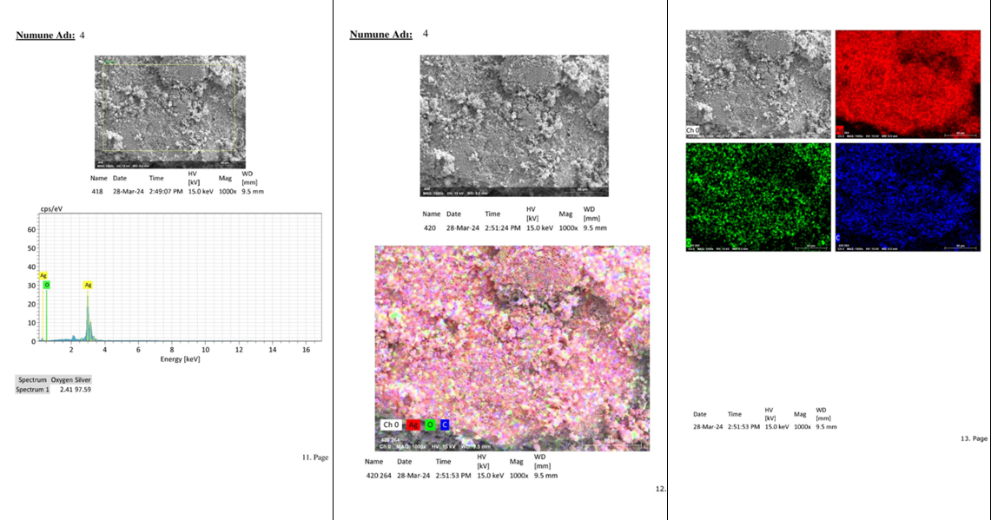
Results and Discussion
TURK2025
Outline
Introduction
Materials and Method
Results and Conclusion
Figure 2. The SEM-EDS image of silver nanoparticles synthesized with Bitter Melon extract.
Notes:
In general, all thermodynamic properties of fluids used in heat extraction from the thermal systems are important. The specific heat capacity and viscosity of the fluid is determinative in the first place in terms of the pumping power required to circulate the fluid in the system.
For air and water, the flow rate of the fluid that corresponds to the total heat required to be drawn from the system is high due to lower specific heat capacities.
Whether it is an air fan or a water pump, greater flow rates require more power to circulate the fluid. As can be seen in the graph, the pumping power required to draw a certain amount of heat with encapsulated PCM slurries is gradually lower compared to pure water, especially for higher rates.
For example, in order to draw 1000 Watts of Heat, with pure water we need almost five folds pumping power.
Also, the relationship between the pumping power and the heat drawn is parabolic for pure water, while it is almost linear for aqueous encapsulated PCM slurries.

Slide 20
Overview
TURK2025
Based on the experimental results and the modified synthesis method, it was confirmed through characterization data that silver nanoparticles were synthesized homogeneously at a small size. Silver nanoparticles with a uniform morphology and a size of approximately 10 nm were successfully obtained. Nanoparticles of this size have potential applications in a wide range of fields. Therefore, the obtained particles will be utilized in further research.
Outline
Introduction
Materials and Method
Results and Conclusion
Notes:
Using ePCM slurry as the working fluid, thermal efficiency, electrical efficiency, hence the overall efficiency increase with almost no increase in the pumping power. For some specific figures the yields are more better.
Therefore a precise system configuration and modelling is also important.
As a result, In thermal systems in which encapsulated PCM slurry is used as the working fluid, both thermal and electrical efficiency can be improved.

Slide 21
Thank you for listening
TURK2025
Outline
Introduction
Materials and Method
Results and Conclusion
This research was supported by the Scientific Research Projects Coordination Unit of Sakarya University of Applied Sciences under Project No. 170-2023.
Notes:
I would like to thank you and to all attendees for your time and patience.
Further details can be found in our paper. And we welcome any questions, comments or recommendations directed to our contact e-mail address.

